Slide 1

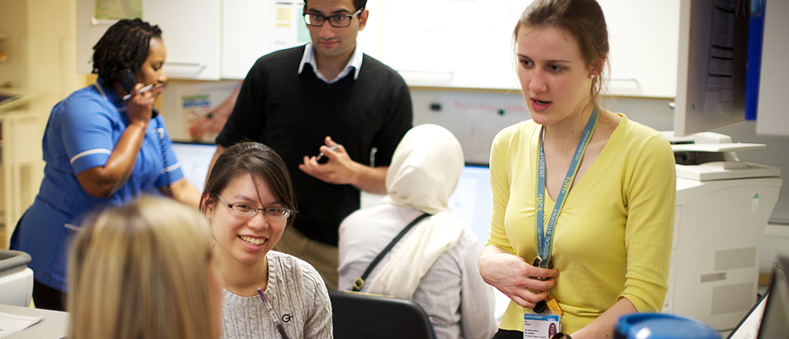

Differential Attainment
Rupal Shah

Slide 2
Differential attainment
Unexplained variation in attainment between groups who share a protected characteristic and those who do not share the same characteristic
In broad terms, across ARCP, Recruitment and Exams the following groups tend to perform less well
  Male
  Older
  Black, Asian and Minority Ethnic (BME)
  International graduates
Notes:
Differential attainment (DA) is a term used to describe situations where groups who share protected characteristics are less successful than other groups.
Differential attainment exists across many of the characteristics protected by the Equality Act 2010 for example:
Gender: Men have poorer exam results than women.
Race: Black and minority ethnic doctors have lower pass rates than their white counterparts.
This has been recognised as a challenge for medical professionals and educators since the 1990s, and has been observed in both undergraduate and postgraduate contexts. It’s not limited to medical education, it occurs in many other professions.

Slide 3
Differential Attainment
The average postgraduate exam pass rate for all UK medical graduates is 71%
This rises to 75.8% for those who are White
This falls to 63.2% for UK BME medical graduates
This falls to 41.4% for International Medical Graduates (GMC 2015)
@NHS_HealthEdEng #insertcampaignhashtag

Slide 4
Differential Attainment
BME candidates are less likely to be accepted onto specialty training programmes (72% vs 81%) GMC 2015
Large systematic review 2011 (Woolf) - 23,742 medics. Difference in performance across undergraduate and postgraduate assessments - 2.5x higher odds of failure
Differences across other HEIs (Mountford- Zimdars 2015)

Slide 5
Differential Attainment
Does this fit with your experience?

Slide 6
Causes
No evidence for:
Examiner bias (but cultural bias)
Socioeconomic difference
Language (but consider sociocultural difference)
Pre-university attainment (Woolf 2013)
Therefore is the trainee deficit model valid?

Slide 7
Causes
Unclear and complex
Review across HEIs (Mountford-Zimdars 2015):
- Curricula and learning
- Social, cultural and economic capital
- Relationships between staff and students
- Psychosocial and identity factors
GMC – simple linear interventions unlikely to work.

Slide 8
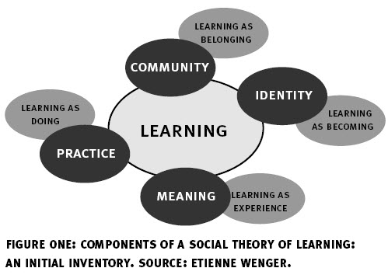

Slide 9
Social Capital
Homophily
Bridging Social Capital

Slide 10
Relationships
Sponsorship
Unconscious Bias
Teacher expectations

Slide 11
Identity
Self Efficacy
Belonging, Inclusion
Stereotype Threat

Slide 12
I’m expecting to get a lower mark because I’m- I know it’s a stupid way of thinking but actually it got to the point where I was thinking “What is it? Am I…?” I wasn’t sure if it was my knowledge anymore, I wasn’t sure if it was my confidence, I wasn’t sure if it was my skin colour. So you start-I think it creates almost like a nasty way of thinking and how you perceive yourself to be. And if that someone’s expectation of you is low subconsciously, your performance will be low’.

Slide 13
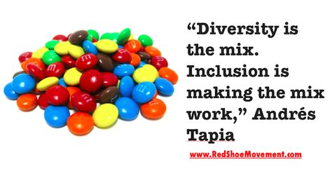
Inclusion
Inclusion is what we do with diversity - when we value and appreciate people because of and not in spite of their differences, as well as their similarities.
https://www.dailymotion.com/video/x7sr3t

Slide 14
Inclusion - questions
How might your department be viewed by an outsider?
What would you advise a doctor joining your department from abroad about how to fit in (how much would they have to change about themselves)?

Slide 15
Standard Setting
‘I’ve been in this country for more than a decade now. It’s still a learning journey […] I personally think that maybe there must be some time given us to relearn what we have learnt already and then learn what we are supposed to learn’

Slide 16
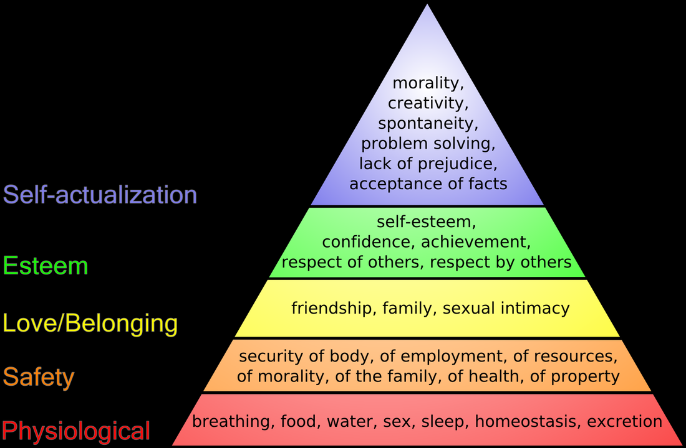

Slide 17
Ways Forward
How can we increase the ‘bridging social capital’ of BME medics?
How can we address unconscious bias?
How can we increase the feeling of belonging experienced by BME medics and decrease stereotype threat?
Standard setting

Slide 18
What should be done differently (in your department) to promote inclusion?
What could you do differently?

Slide 19
Promoting Cultural Safety
Identifying what makes someone else different is easy e.g. their English isn’t very good or they don’t do things in the same way as others.
Understanding our own culture, and it’s influence on how we think, feel and behave is much harder.
Morris (2010)
Notes:
Psychological safety – “being able to show and employ one's self without fear of negative consequences of self-image, status or career" (Kahn 1990, p. 708).
Psychological safety describes a climate where people recognize their ability and responsibility to overcome fear and reluctance to speak up with potentially controversial ideas or questions.
Psychological safety is a property of the team as a whole. It is not enough for a few team members to feel comfortable speaking up, even if one of them is the team leader. If others on the team remain hesitant to contribute their views, the team is still likely to suffer the consequences of a psychologically unsafe climate.
For team leaders and other senior members, their own comfort in speaking up is probably less important for establishing psychological safety than the way they respond when other members voice concerns.
How can team members foster psychological safety? Simply by starting small. Take small risks by picking spots to challenge one another or contribute a new idea. Ask someone else to weigh in with their expertise, even when (or especially when) you think it might challenge your own thinking. When team members think that their expertise is valued, good things happen. Small risks that end well are emulated. Acknowledging and appreciating a team member who takes such a risk - offers a new idea, admits an error, asks a question - is a powerful tactic for inspiring others to follow suit. This is especially important in diverse teams, where members may not share similar assumptions and experiences.

Slide 20
Promoting Cultural Safety
Reflecting on one’s own culture, attitudes and beliefs about ‘others’
Clear, value free, open and respectful communication
Developing trust and being aware of power imbalances
Recognising and avoiding stereotypical barriers
Recognising biases and their impact
Being prepared to engage with others in a two-way dialogue where knowledge is shared
Notes:
Psychological safety – “being able to show and employ one's self without fear of negative consequences of self-image, status or career" (Kahn 1990, p. 708).
Psychological safety describes a climate where people recognize their ability and responsibility to overcome fear and reluctance to speak up with potentially controversial ideas or questions.
Psychological safety is a property of the team as a whole. It is not enough for a few team members to feel comfortable speaking up, even if one of them is the team leader. If others on the team remain hesitant to contribute their views, the team is still likely to suffer the consequences of a psychologically unsafe climate.
For team leaders and other senior members, their own comfort in speaking up is probably less important for establishing psychological safety than the way they respond when other members voice concerns.
How can team members foster psychological safety? Simply by starting small. Take small risks by picking spots to challenge one another or contribute a new idea. Ask someone else to weigh in with their expertise, even when (or especially when) you think it might challenge your own thinking. When team members think that their expertise is valued, good things happen. Small risks that end well are emulated. Acknowledging and appreciating a team member who takes such a risk - offers a new idea, admits an error, asks a question - is a powerful tactic for inspiring others to follow suit. This is especially important in diverse teams, where members may not share similar assumptions and experiences.

Slide 21
Cultural Humility
Being self aware enough to understand how bias and power imbalance might affect every encounter we have with patients and colleagues
Notes:
Psychological safety – “being able to show and employ one's self without fear of negative consequences of self-image, status or career" (Kahn 1990, p. 708).
Psychological safety describes a climate where people recognize their ability and responsibility to overcome fear and reluctance to speak up with potentially controversial ideas or questions.
Psychological safety is a property of the team as a whole. It is not enough for a few team members to feel comfortable speaking up, even if one of them is the team leader. If others on the team remain hesitant to contribute their views, the team is still likely to suffer the consequences of a psychologically unsafe climate.
For team leaders and other senior members, their own comfort in speaking up is probably less important for establishing psychological safety than the way they respond when other members voice concerns.
How can team members foster psychological safety? Simply by starting small. Take small risks by picking spots to challenge one another or contribute a new idea. Ask someone else to weigh in with their expertise, even when (or especially when) you think it might challenge your own thinking. When team members think that their expertise is valued, good things happen. Small risks that end well are emulated. Acknowledging and appreciating a team member who takes such a risk - offers a new idea, admits an error, asks a question - is a powerful tactic for inspiring others to follow suit. This is especially important in diverse teams, where members may not share similar assumptions and experiences.

Slide 22
Appreciative Inquiry
Seeks to identify what is going well in a situation and what the learner’s strengths are
Mobilises individual and collective strengths to achieve potential
Creates a vision of change which is congruent with the learner and with their organisation – co-creating goals

Slide 23
People do not grow by concentrating on their problems. In fact, the effect of a problem focus is to weaken people’s confidence in their ability to develop in self-reflective ways. The fact that people have lacks is acknowledged, but the best strategy for supporting further gains is a conscious emphasis on the gains already made’ Weick 1989

Slide 24
Possible ways forward –IMG doctors
Random allocation to training placements to avoid clustering
Bespoke learning programmes for IMG trainees
Active encouragement to increase cultural knowledge (Patterson 2018)
GMC welcome to UK practice programme
IMG Champions

Slide 25
Possible ways forward
Evidence for interventions less clear for UK trained BME medics
Whole department or individual interventions
Mentoring
Early identification of trainees at high risk of failing (ITAP in-training assessment profiler –ES report; PSQ/ MSF; assessment score) and targeted interventions
Cultural humility programmes
Challenging institutional racism

