Slide 1


Supervising clinicians from diverse language and cultural backgrounds
Lynne Rustecki
Education Lead
Professional Development Team

Slide 2
Session outline
Orientation: identifying challenges
Cultural awareness in the training relationship
Building the toolkit – developing skills

Slide 3
Sharing experiences
What additional challenges to progression are there for trainees educated overseas?
What are the challenges for their educators?

Slide 4
IMG voices
Podcast : Culture and concepts of professionalism
: https://www.youtube.com/watch?v=ZFBtakvl8yA

Slide 5
Challenges for IMGs
Language:
  Communicating with patients
  Communicating with colleagues
Cultural factors:
Concepts of professionalism
Systems, protocols
Professional relationships
Teaching and Learning

Slide 6
Language
Linguistic resource: grammar, vocabulary, pronunciation
Sociolinguistic style (‘manner’): pace, intonation, directness, body language etc
Applied language (models of communication): consultation skills, handover, meeting skills

Slide 7
Language and relationships
Language is not just a set of forms, but a social construct
Communication has both a content and a relationship dimension ('not just what you say, but the way you say it')
Rapport can be built or damaged through discourse (Spencer-Oatey 2005)
Interactional norms differ between speech communities and even regional varieties of a language

Slide 8
Language ‘transfer’
Language patterns (grammar, vocabulary, pronunciation) are often transferred from L1 to L2
Minor language errors may often go unnoticed by L1 listeners if overall meaning is clear
Sociolinguistic differences can be more problematic and are often more harshly judged (Woolfson 2002)
Appropriate ‘style’ depends on implicit language and cultural norms
L1 = native language, L2 =second language

Slide 9


How many different ways can you ask someone to open a window?

Slide 10
Native speakers can adapt phrasing to context
Open the window please
I wonder if you would mind opening the window?
Would it be ok to open the window?
Open the window for me, would you?
Is it hot in here or is it me?

Slide 11
Interpreting attitude
How do you recognise politeness? empathy? interest?
What about boredom? anger?
Are these signals transferrable across cultures?
What assumptions do we make when we interact with L2 speakers?

Slide 12
Developing cultural awareness in the training relationship
DA risks to progression:
Relationships with seniors – crucial to learning and development but sometimes ‘problematic’
Perceived bias in recruitment and assessment, particularly WPBA, less so in Royal College exams
Lack of support outside work – little autonomy in choice of rotations, separation from family and friends, workplace stress/work-life balance

Slide 13
Developing cultural awareness in the training relationship: discussion themes
What do we mean by ‘culture’?
Intent and effect
Culture and concepts of professionalism

Slide 14
What do we mean by ‘culture’?
‘The collective programming of the human mind that distinguishes the members of one human group from those of another’ (Hofstede)
‘Primarily a system for creating, sending, storing and processing information’ (Hall and Hall)
‘The man-made part of the human environment’ (Herskovits)
‘..an integrated pattern of learned beliefs and behaviours that can be shared among groups… that shapes how we explain and value our world, and provides us with the lens through which we find meaning’ (Bettancourt)
‘The way we do things round here’

Slide 15

Culture as an iceberg

Slide 16
Culture as an iceberg
Behaviours =‘principal manifestation’ (Storti 2002)
Significance may be misinterpreted
Based on deeply held values, often out of awareness
Many ‘rules’ hidden to others - posing a potential hazard
Influence of early socialization is most resistant to change (Hall 1997)

Slide 17
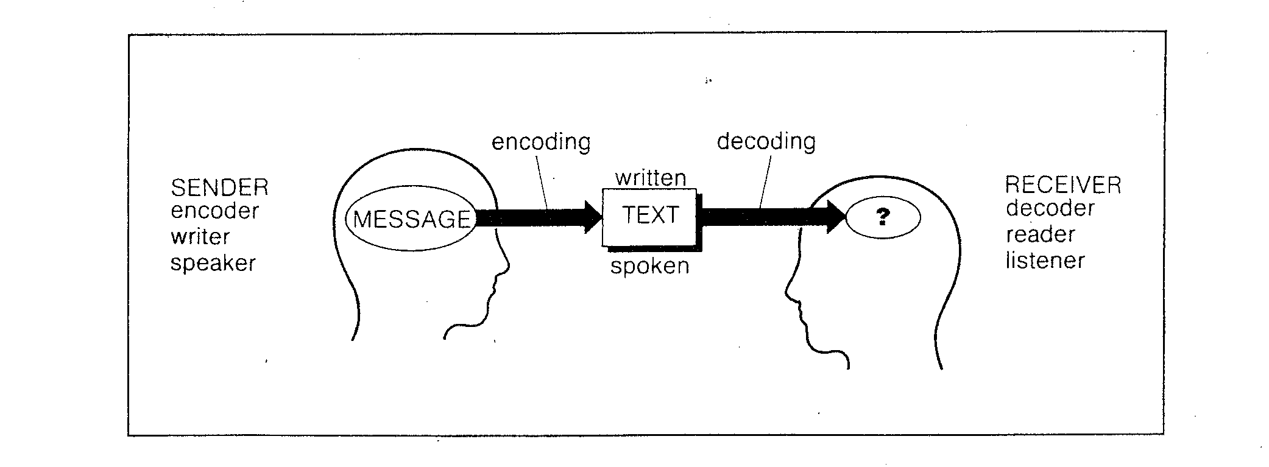
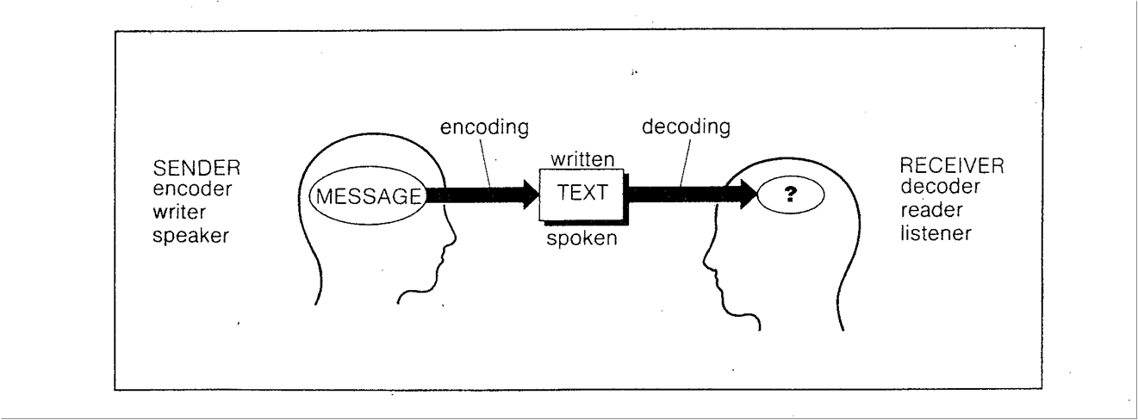
Communication: Intent and effect

Slide 18
Communication: intent v effect
Decoder filters message through own perceptual and conceptual expectations and assumptions
Our own culture limits ‘the predictions we make about how strangers might respond’ (Gudykunst & Kim)
Ethnocentric position: cause of misunderstanding may be generalised as
’language barrier’
behavioural/attitude issues
poor communication skills

Slide 19
Reflecting on assumptions
Vignettes

Slide 20
Building the toolkit
The role of trust in the training relationship
Negotiating the learning contract
Precision feedback

Slide 21
Building Trust
Evidence of powerful benefits from trusting relationships with supervisors
Cognition-based trust is ‘confidence built on perceptions of the other’s reliability and competence’
Affect-based trust is defined as ‘trust that involves concern for the other, and comfort in opening up to them’ and is based on empathy and care
Both kinds of trust may be more difficult to develop in intercultural relationships
Woolf 2017
McAllister 1995; Chua et al 2011
Rockstuhl and Ng, 2008

Slide 22
Negotiating the learning contract
IMGs’ educational experiences may be very different from UK graduates’
key concepts may be new or differently understood (self-directed learning, questioning seniors, giving and receiving feedback)
‘insight’ may be a cultural construct in itself
behaviours may be misinterpreted on both sides
need to clarify expectations, approaches and roles

Slide 23
Cultural values can impact on:
formality of interaction (use of names, dress, setting. humour?)
expectations around autonomy, direction and influence
willingness to challenge; showing initiative
self-disclosure and boundaries (socialising)
giving and receiving feedback (setting- public or private; directness/hedging; specific/general)

Slide 24
Language: useful terms for precision feedback
Fluency – speech is produced spontaneously, at ‘normal’ speed without obvious hesitation
Accuracy - ‘correct’ grammar and appropriate vocabulary choice for context
Pronunciation – speech is easily understood, pace and rhythm do not ‘strain’ the listener
Intonation – attitude is effectively conveyed
Participation – contributions are appropriate in length and relevance, turn-taking is balanced

Slide 25
Mind your language
Discuss these statements. Why might they be challenging for non-native speakers?
‘This is a barn-door case of meningitis’
‘You will have protected time for self-study’’
‘He is a single-handed GP’
‘Something came up so we’ll have to put it off’
‘I’m afraid that might be a bit tricky
‘They thought he’d turned the corner, but then they lost him’
She's a real Jekyll and Hyde character

Slide 26
Monitor your speech
To maximise clarity, try to avoid:
Idioms (expressions that have a non-literal meaning)
Colloquialisms (informal or local language)
Institutionalised phrasing (terms specific to NHS)
Abbreviations/acronyms
Phrasal verbs (2-part verbs such as put up, put up with, put through, put out, put by, etc)
Cultural references
Excessive 'hedging'

Slide 27
Mind your language: review
‘This is a barn-door case of meningitis’ (idiom)
‘You will have protected time for self-study’ (institutional language)
‘He is a single-handed GP’ (idiom)
‘Something came up so we’ll have to put it off’ (phrasal verbs)
‘I’m afraid that might be a bit tricky’ (indirectness/hedging)
‘They thought he’d turned the corner, but then they lost him’ (idiom)
She's a real Jekyll and Hyde character (cultural reference)

Slide 28
Reflection and further discussion

Slide 29
Resources
Specialist Clinical Communication and Linguistic Services: HEE London and SE Professional Development Team:https://www.lpmde.ac.uk/professional-development/sccls
Pilotto et al, (2002) Issues for clinicians training international medical graduates: a systematic review (MJA Vol 187 Number 4)
AFMC, Faculty development program for Teachers of IEHPs: http://www.afmc.ca/img/default_en.htm
Spencer Oatey, H. (2005). Rapport Management Theory and Culture
Rustecki et al, (2008) Assessing the Communicative Competence of EU GPs Applying to Work in London Education for Primary Care Vol 22

