Slide 1


Challenging Conversations
Dr Helen Halpern & Ms Diana Kelly

Slide 2
Aims of workshop
to provide resources and support for holding challenging conversations that arise because of issues related to differential attainment
to provide an inclusive and constructive forum to promote learning and develop skills in managing challenging conversations with individuals and groups
to develop skills in group facilitation

Slide 3
Learning Outcomes
to identify key concerns about holding a challenging conversation relating to differential attainment
to share experiences and ideas about supporting colleagues working with or managing people experiencing difficulties due to differential attainment
to consider the usefulness of Conversations inviting Change as an approach to managing difficult conversations
to take part in a collaborative learning group and analyse its effectiveness
to develop strategies for managing challenging conversations
to access resources for further information and training

Slide 4
Lesson Plan
Introductions
Review of learning needs
Key challenges
Facilitating difficult conversations:
Conversations inviting Change
Break
Small group work
Plenary

Slide 5
Review of Learning Needs
What do you want to get out of today’s workshop?

Slide 6
Key Challenges
What challenges have you faced relating to differential attainment?
What have you learnt already about addressing these challenges?

Slide 7
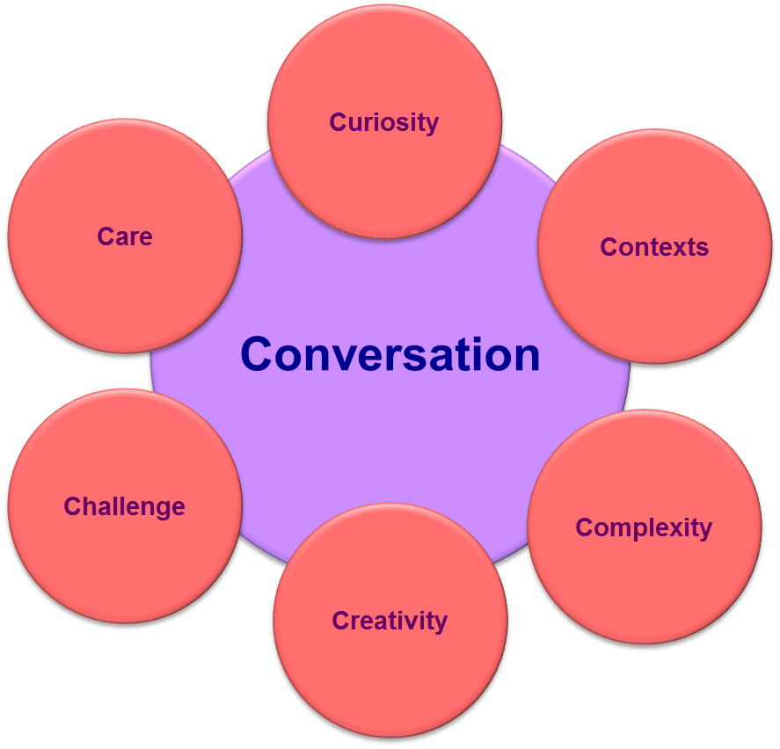
Conversations inviting Change - the ‘7 Cs’

Slide 8

Conversation

Slide 9
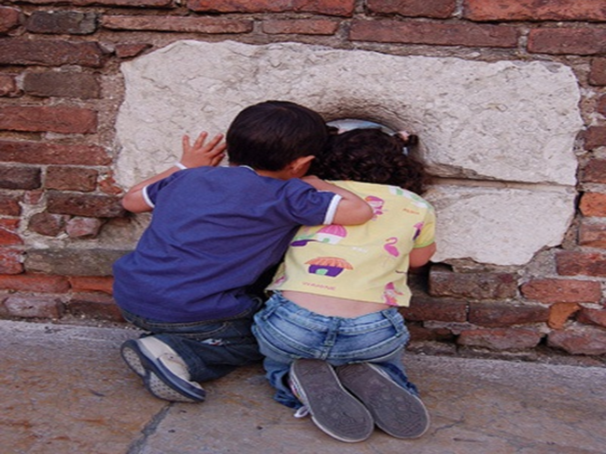

Curiosity

Slide 10

Context

Slide 11

Complexity

Slide 12
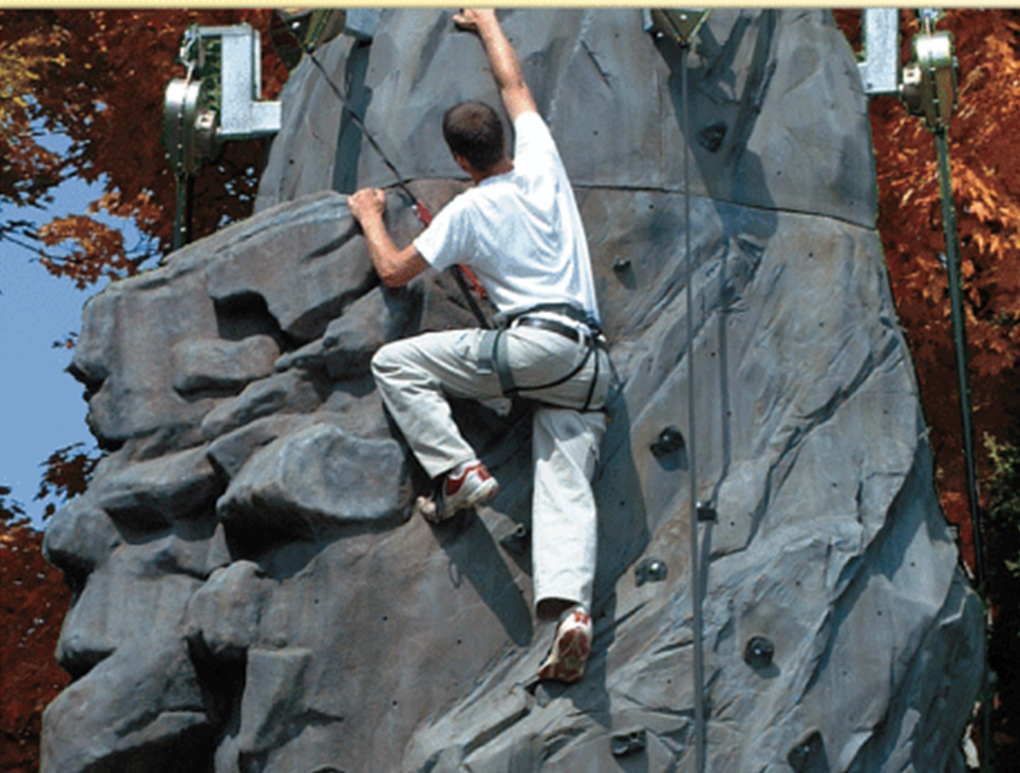
Challenge

Slide 13

Caution

Slide 14

Care

Slide 15
The 7 Cs
How does your C relate to Differential Attainment?

Slide 16
Plenary
What will you take away to apply
in your workplace?

