Slide 1
FFPMRCA
Exam Resources & Structure
C.C & E.H 2021

Slide 2
Resources
Textbook of Pain - Wall & Melzacks
Oxford pain management Management Library (short text books)
CEACCP/BJA Articles
Neuroanatomy – Crossman & Neary

Slide 3

Resources

Slide 4
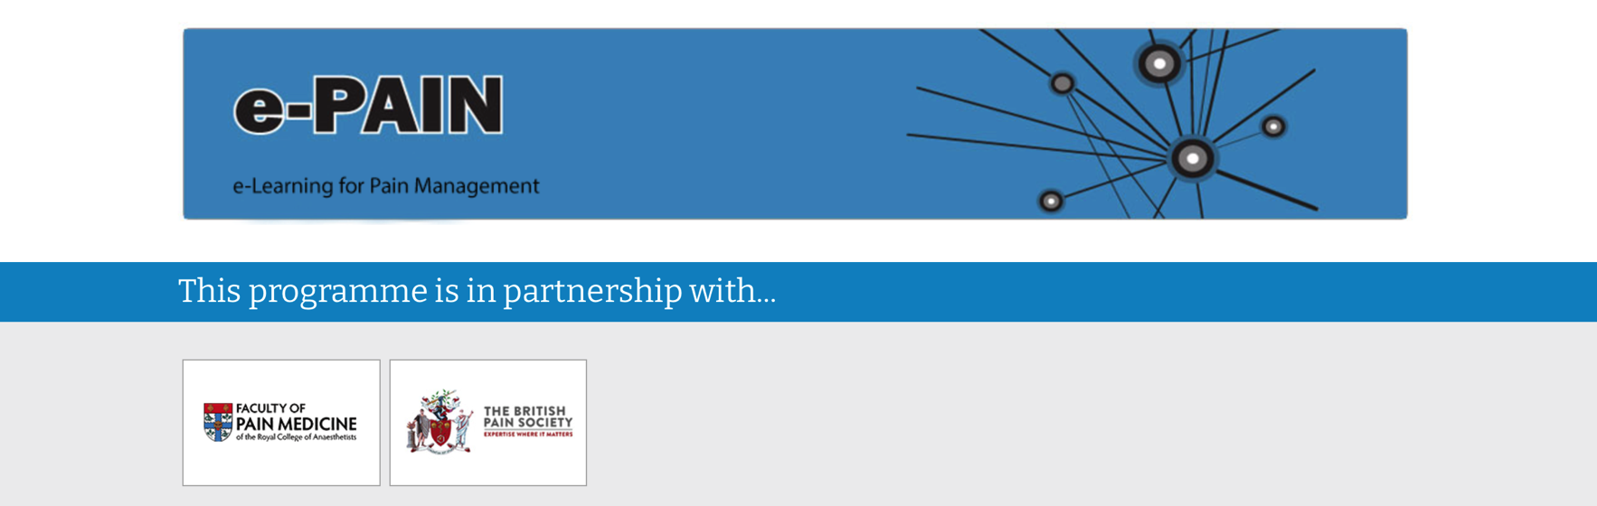
Resources

Slide 5

Resources

Slide 6

Psychology

Slide 7
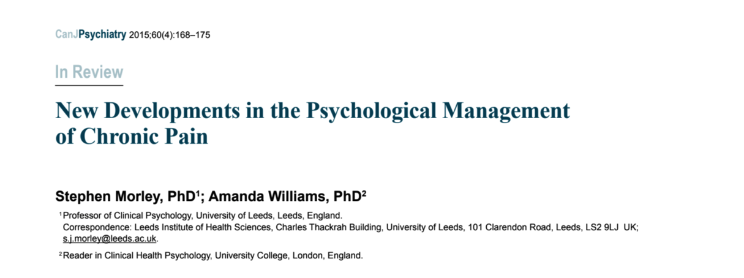
Psychology

Slide 8
Statistics
CEACCP, 2007
  Statistics 1, 2 & 3
NNT, NNH, ARR, RRR, RR
NICE grade of recommendations
  A-D
Levels of evidence
  1a, 1b, 2a, 2b, 3, 4
Clinical Trials – How to design, Phase 1 – Phase 4

Slide 9
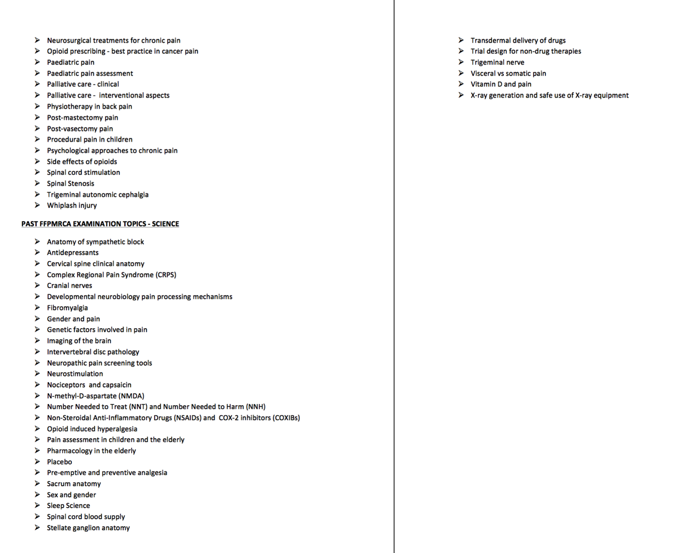
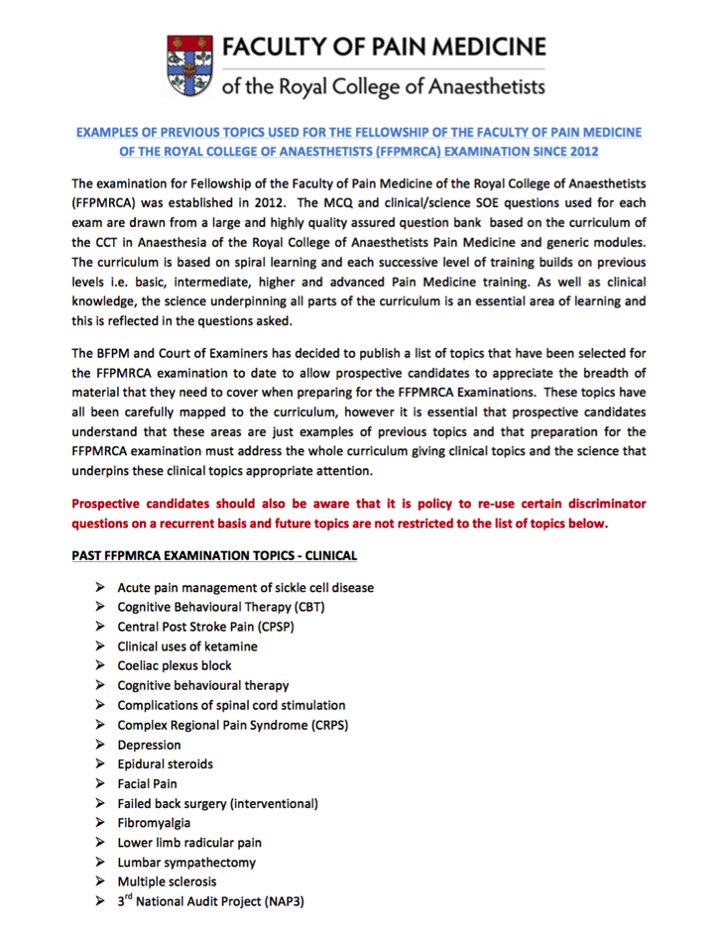
FPM

Slide 10
MCQ - Structure
MTF
  40 True-False each with 5 items
SBA
  25
EMQ
  25 (5 topics)

Slide 11
MCQ’s - Resources
CEACCP/BJA articles relating to pain – MCQ’s at end of article
ePAIN MCQ’s
Final FRCA MCQ book (pain related questions)

Slide 12
SOE
SOE1 (Clinical)
  52 minutes
  1 long case (10 mins prep, 21 mins questions)
  3 short cases (3x7 mins)
SOE2 (Clinical Science)
  30 minutes (4 sections)
  Anatomy
  Physiology
  Pharmacology
  Psychology, Epidemiology & Clinical Measurement

Slide 13
SOE – Long Case
Given a case with results/investigations – 10 mins
Allowed 1 sheet of paper to write notes on
Asked to summarise case
Differential Diagnosis
More detail about case/topic

Slide 14
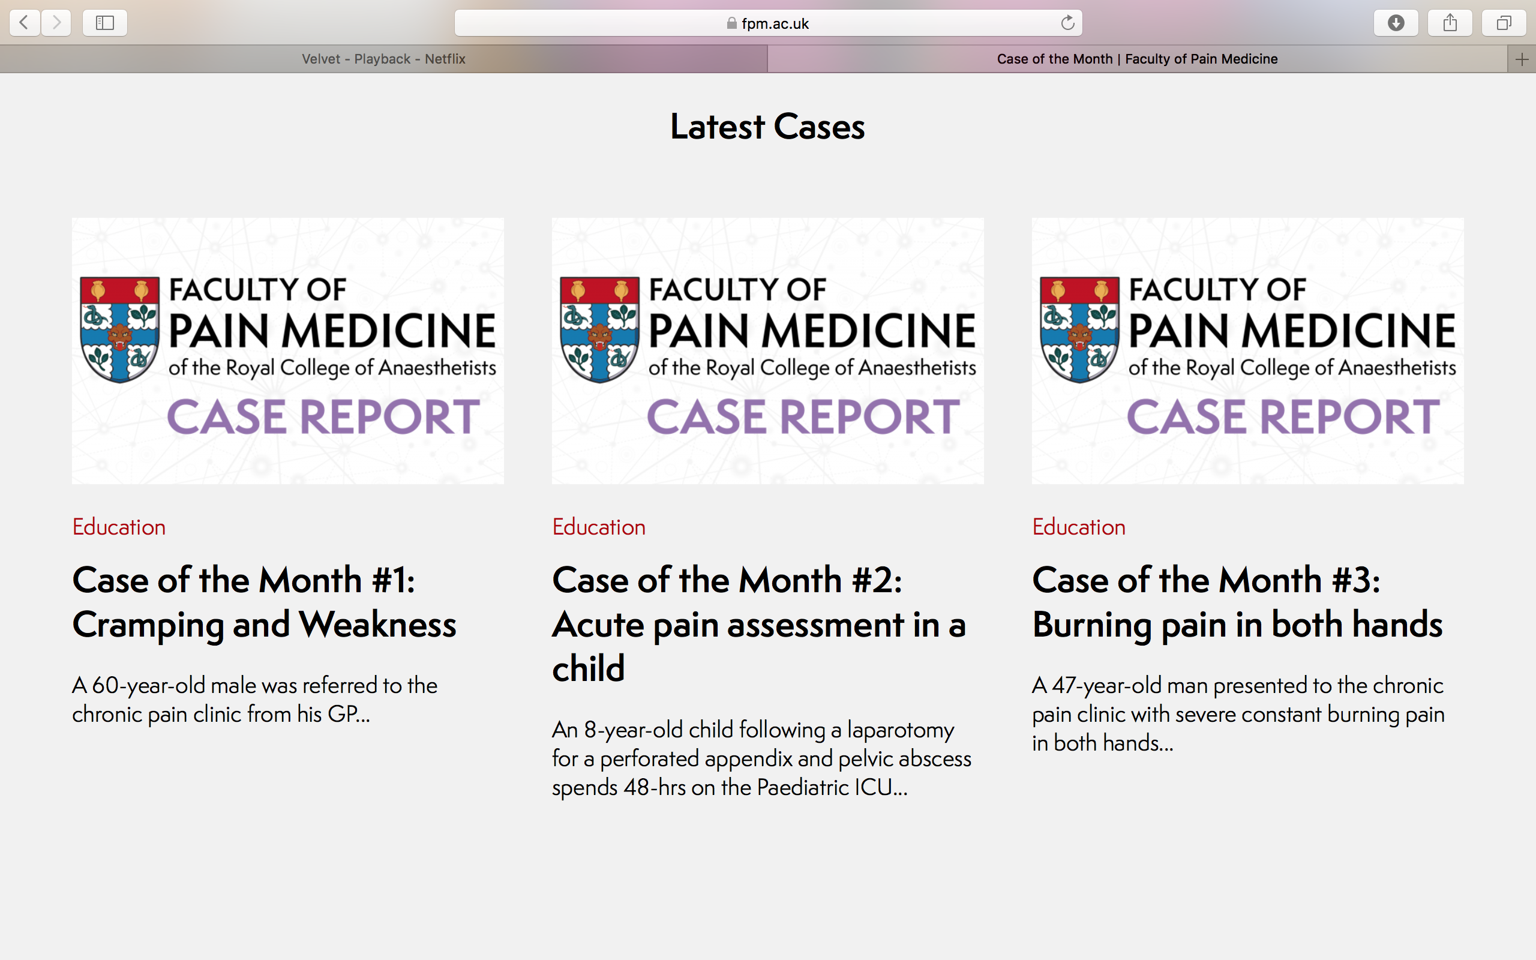
SOE – Long Case

Slide 15
Guidelines
IASP – Definitions
ICD-11 – Definitions
  Chronic primary pain/secondary pain
NICE Guidelines
SIGN Guidelines
BPS Guidelines
GMC Good Practice Guidelines

Slide 16
Specific Guidelines
British Geriatric Society – Assessment of pain in older people, (2018)
Royal College of Physicians – CRPS, (2018)
American College of Rheumatology (2016) & EULAR recommendations (2017) – Fibromyalgia
NAP3 – Complications with neuraxial block

Slide 17
Outcome Measures
BPS/FPM joint document - 2019

Slide 18
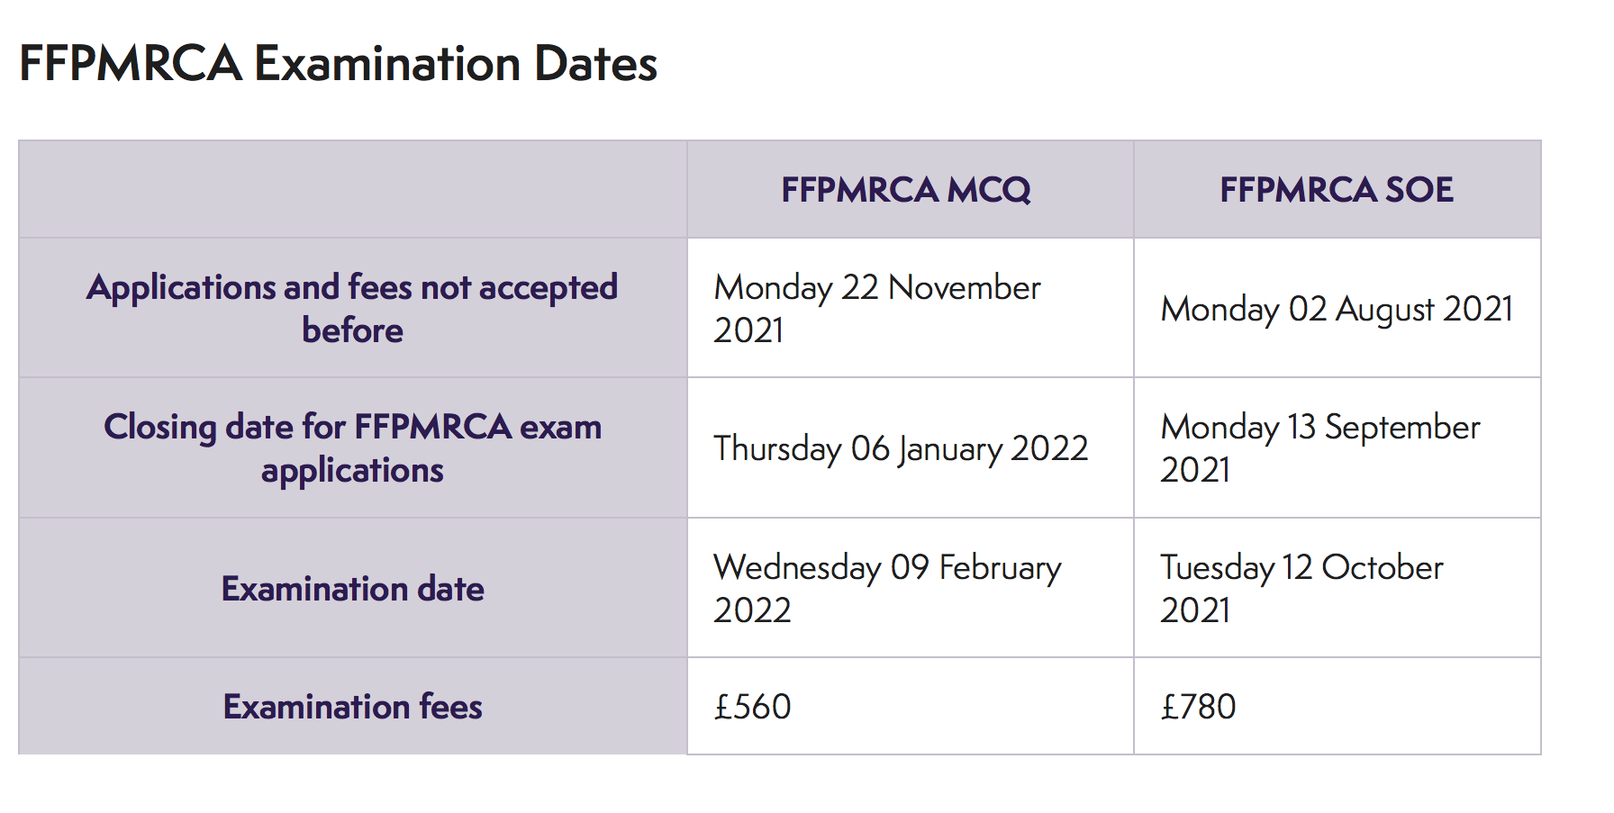
Upcoming Exam dates

