Slide 1
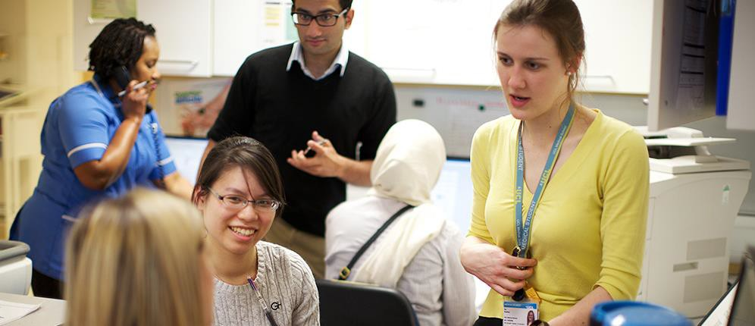

Revision and examinations
Carol Leather

Slide 2

Overview
The challenges of revision
Learning and information processing and revision
The importance of planning
Examinations: the challenges
The process and performance
Case studies

Slide 3
Revision-what are the challenges ?

Slide 4
What is learning and information processing?
Gaining knowledge, using it
It is determined by way we perceive, process, store
and retrieve information from experience
Learning occurs through guidance and errors
It occurs through experience and practice
What is revision ?
What are the barriers ?

Slide 5
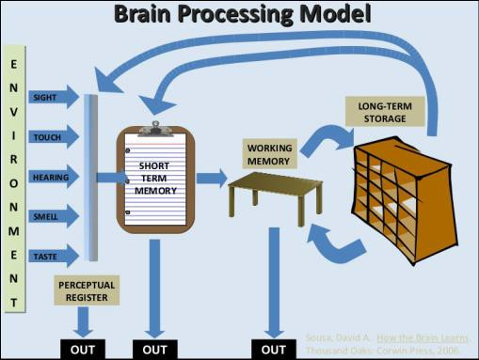
The acquisition of knowledge
Working memory
Mastery and understanding
By not knowing and forgetting
What are the learning / processing channels ?
What are the most effective?

Slide 6
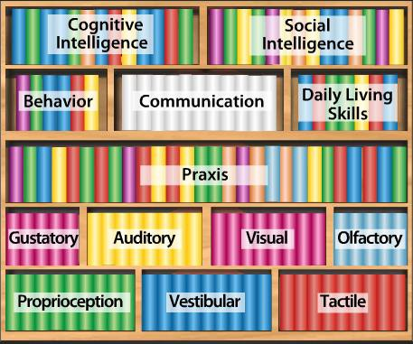
Storage is important
A Library has two functions:
to store information
to help you gain
access to that information-- good storage systems in the brain help recall
Organising and making information meaningful aids memory retention and retrieval

Slide 7
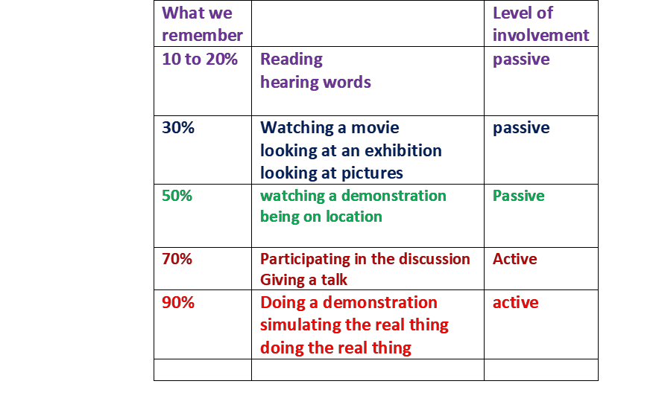
Revision strategies
Active, passive or rote
Is it wrong to just do questions ? Beware the recognition trap!
(recognising something on a page passive-
it is not necessarily knowing it, being able to recall it)
Different information requires different learning strategies
Source Edgar Dale (1969)

Slide 8
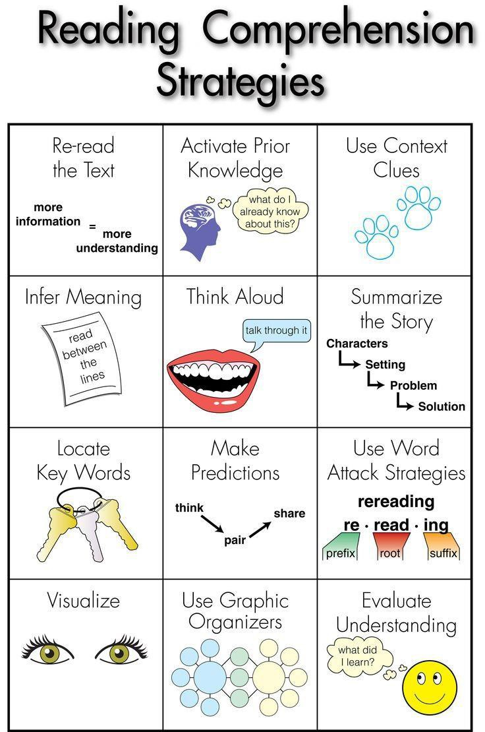
Effective learning
Multi sensory learning is the best !!
4 M’s
Manageable - plan it, break it into bits
Meaningful - look for the structure, activate prior knowledge
Multi sensory - incorporate the senses
Memory aids – task specific techniques
The goals
To know the material -- to recall it -- self test
To be able to use it in examinations
To apply it in other scenarios
Revision outcome: more confident in a
clinical setting and pass exams !

Slide 9


The importance of planning
Why don’t people plan ?
Fear
Never stick to it – keeps changing
Don’t know how to do it or
where to start
Wastes time
Why should people plan ?
Planning, preparation and
practice improve performance
Ensures much of the knowledge is refreshed
Improves recall
Increases confidence

Slide 10
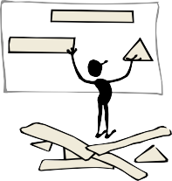
How to plan
Think strategically
Evaluate your knowledge
base – self test – prioritise
Analyse what you have to learn - difficulty/ interest / type of information
Task specific method - best way
Make it manageable, multi sensory, meaningful, memory aids
Be goal orientated
Look / fit to time frame- e.g.
Outlook
Pre set daily /weekly goals – short achievable goals -check and reflect
Make the best of your energy and time --- be flexible
Reflect
Be organised, creative and
enjoy it !

Slide 11
Exams- what are the challenges?

Slide 12
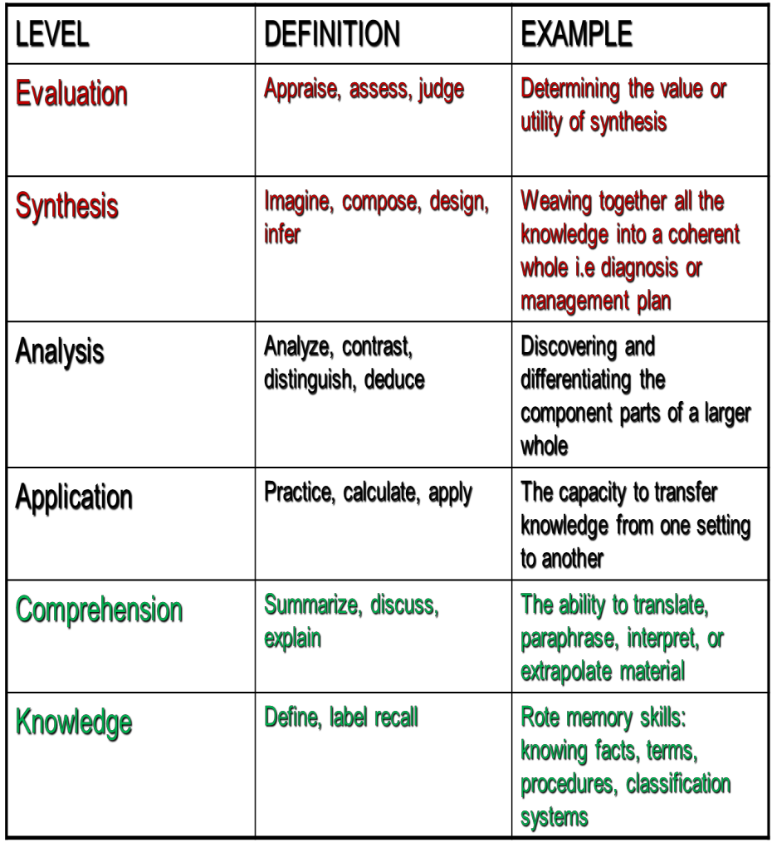
The examination process
The rationale:
The what, the why, the how
The impact on the individual
Blooms Cognitive domain

Slide 13
How do you do the written exams (e.g. MCQs)
Cover up the potential answers
Read the question sentence
What do YOU think the answer is?
Think about the context
Where is the answer ‘located’ in the text – what are
the variables- age gender etc ?
Check your answer against what is offered
Beware changing your answer in the examination

Slide 14
Practical exams (e.g. CSA, PACES, OSCE’s)
Planning, preparation, practice
Distinguish between:
Those with ‘an answer’
Those which require ‘judgement’
Take your time to think
Understand your own ‘stress reaction’– Breathing is good for you!
The challenge is part of the process – test of your confidence in your skills & knowledge

Slide 15
Be strategic :
Preparation – are you getting ‘exam ready’ – energy,
approach, confident, philosophy
Plan an exam strategy:
Chunking - time allocation - ‘gold silver bronze’ method any others?
Practice
MCQ’s - mock papers, timed questions, banks
CSA, PACES, Viva’s - with others

Slide 16
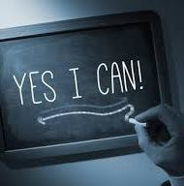
On the big day
You should feel:
exam ready
well prepared
philosophical
excited
rested
confident

Slide 17

What are the keys to success ?

